Slide 1
Natural Hazards
7th Grade Science

Slide 2
How can the environment change?
There are various factors that can change the environment.
1) natural hazards
2) changes in populations
3) limiting factors
These changes can have an effect on the amount of resources available in the environment.
This can lead to competition for food, water, space, or shelter.

Slide 3
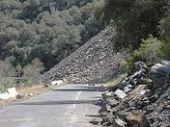
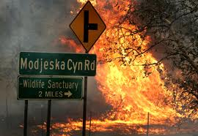
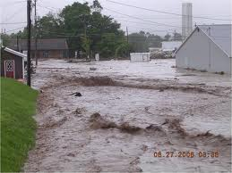
Natural Hazards
Landslides
Wildfires
Floods

Slide 4
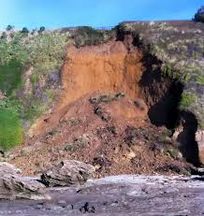
What is a landslide?
Landslides are large areas of ground movement of rock, earth, or debris that fall, slide, or flow on slopes due to gravity.
They can occur in any environment given the right conditions of soil, moisture, and the angle of slope.

Slide 5
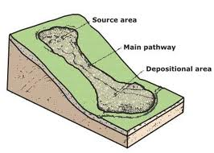
What causes landslides?
Landslides can be caused by:
rains
floods
Steep sloping ground
earthquakes
excessive development
clear-cutting for lumber

Slide 6
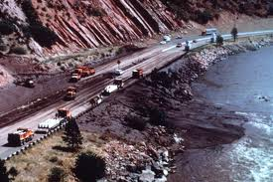
How do landslides effect the environment?
blocking roads
damaging or destroying homes
destroying habitats
disrupting power lines

Slide 7
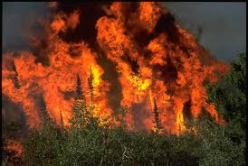
What is a wildfire?
Fire is a natural event in most grassland and forest ecosystems.
Fires can be beneficial to the ecosystem and are an essential component in the life cycle of some trees.

Slide 8
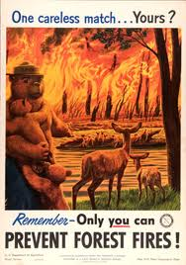
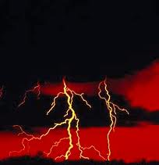
What causes wildfires?
They occur naturally through lightning strikes or when humans start them accidentally or intentionally.

Slide 9
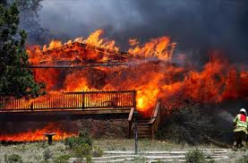
What effect do wildfires have on the environment?
Ability of some seeds to break open so they can germinate
Renews nutrients in soil
Increase in air pollution
Habitat destruction
Destroys homes or property

Slide 10
What is a flood?
A flood is an unusually high water stage in which water overflows its natural or artificial banks onto normally dry land.
There are two basic types of floods.
Regular river flood- water slowly climbs over the edges of a river.
Flash flood- a wall of water quickly sweeps over an area.

Slide 11
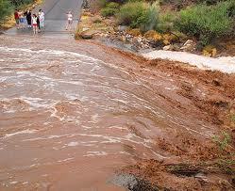
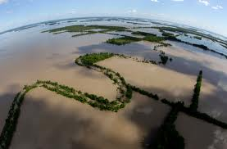
Flash Flood Regular River flood

Slide 12
What is the cause of a flood?
heavy, intense rainfall
over-saturated soil (when the ground cannot hold anymore water)
high river, stream or reservoir levels caused by unusually large amounts of rain
urbanization, or lots of buildings and parking lots

Slide 13
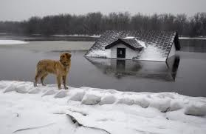
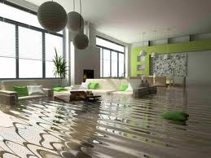
What effects do floods have on the environment?
Damaging property
Endangering humans and animals
Causing soil erosion
Deposition of sediment and nutrients
Creation of fertile soil

